Slide 1
Items You Need for a heifer

Slide 2
Items you need BEFORE purchasing the Animal
Rope Halter
Neck Tie
Feed Bucket
Feed Scoop
Poop Scoop
Water Bucket
Hay Holder
Scrub Brush
Shampoo
(can get all these things from multiple stores, I just picked Tractor Supplies)

Slide 3
Rope Halter
Used for everyday use
Halter breaking the calf
Can come in whatever color you want
About $7-$12 depending on the kind and brand

Slide 4
Neck Tie
Used for another support in keeping calf in one spot
Mainly use it at shows, but can use it at home or barn as well
About $7-$12 depending on the kind and brand

Slide 5
Feed Bucket
I recommend the Big Rubber Feed Buckets
I got mine at Tractor Supply and it worked great
The bigger ones help with them dropping feed from their mouth on to the ground
I say get whatever the animal is comfortable eating out of
Ones I recommend are about $27 at Tractor Supply

Slide 6
Feed Scoop
3 Quart Plastic Feeders
About $3.00

Slide 7
Poop Scoop
I recommend getting one of these on your own
We do have a couple up here at the barn, but if they break, they will not be replaced for awhile
They are about $24 at tractor supply

Slide 8
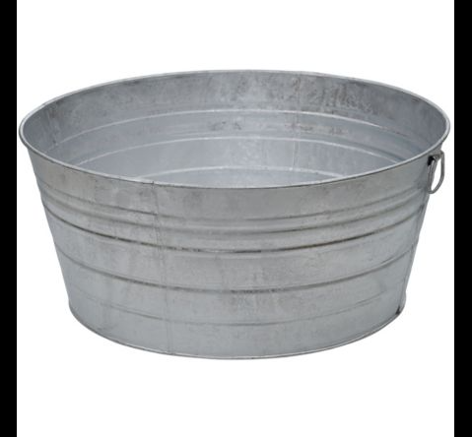
Water Bucket
I prefer the metal kind but you can get the plastic ones as well
Metal one at tractor supplies is $40.00
Plastic one at tractor supplies is $17.99

Slide 9
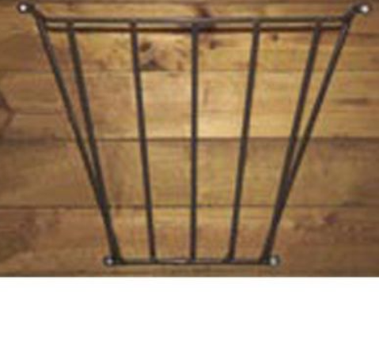
Hay Holder
I had a custom one made that attaches to a piece of ply-wood and had a metal rack on it to hold hay. I can get you one for $15-20 if you would like.
Or you can put the hay in a plastic bucket
Just make sure hay is off the ground while they are in their stale

Slide 10
Scrub Brush
Many different kinds of scrub brushes
Used to help bathe the animal
I get the cheap plastic ones because I used them for many different things
About $8-12 depending on type and brand

Slide 11
Shampoo
Depending on your animal, depends on the shampoos you can use, or need to use
Here is a basic mild shampoo that will get the job done
It’s Weaver brand and you can get it for $14.99 at Tractor Supply

Slide 12
Items you need before a show
Show Halter
Exhibitor Number Holder
Show Stick
Water Bucket
Brushes

Slide 13
Show Halter
Price depends on size, brand, color, and type
Color depends on color of calf you have
Prices are from $40-80 depending on factors
You can get them at Tractor Supply for $45

Slide 14
Exhibitor Number Holder
Need this to hold your exhibitor number and registration papers at shows
Can be as basic or as fancy as you want
Just need basic one for about $40

Slide 15
Show stick
Prices depends on how fancy or basic you want
You just need a basic stick
Length depends on person and calf size
I always get at least a large length
Prices are about $20-40

Slide 16
Small Water Bucket
These make it easy to give water to heifers at shows
Prices vary depending on the kind and brand you get
I like the ones from Sullivans that has the rubber grip on them, but you can get a basic one
Prices range from $10-20 depending on type and brand

Slide 17
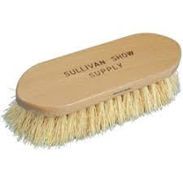
Brushes/Combs
Types of brushes/combs you need will vary depending on type of heifer you have
Americans need brushes
British/Exotic need combs
Prices will vary depending on type and brand

